Slide 1
WEATHER DATA ANALYSIS
HADOOP ECOSYSTEM
Guide:
K.Kanagasabapathi. Asst.Prof
Dept. Information Technology
Dr.Mcet
Submmitted by
K.Hemachandru.(14BIT072)
R.Sekar.(14BIT098)

Slide 2
Weather analytics
Analysis can be done in easier way in spite of small datasets.
In case of large needs and large files for analysis we use hadoop framework for analytics.
It contains the hadoop and mapreduce program to solve our analytics needed.
Hadoop and mapreduce are designed to work parallel to compute large datasets.
Hadoop which is a open source for analytics and we can customize for user convenient.

Slide 3
Hadoop ecosystem needs
Hadoop tar .
Map reduce
It runs on Ubuntu platform. Any versions
Java platform -Eclipse.
Hard ware configurations needed .

Slide 4
Software Requirements:
Hadoop tar file.
Java jdk updated version.
It runs on Ubuntu platform. Any versions(16.04)
Java platform -Eclipse.(neon)
Splunk for visualization.

Slide 5
Hardware Requirements:
Minimum 4 GB RAM
I 5 processor
if vm Ware is needed, System must need virtualization.

Slide 6
Steps for installation:
Create the project code for our convenience of output needed.
Import the project in eclipse IDE in the same way it was told in earlier guide and change the jar paths with the jar files present in the lib directory of this project.
When the project is not having any error, we will export it as a jar file, same as we did in mapreduce guide. Right Click on the Project file and click on Export. Select jar file.
Give the path where you want to save the file.

Slide 7
cond…
Select the main file by clicking on browse.
Click on Finish to export.
Weather.txt is our Dataset for our project it size measures upto 1.2 mb . we can extent upto tb’s and more.
Before running the mapreduce program to check what it does, see that your cluster is up and all the hadoop daemons are running.

Slide 8
Hadoop configuration
Job tracker
It coordinates and schedules all task to run on task trackers.
If it receives the error message it once again it reschedule it on a different task tracker.
It is also called as MASTER NODE.
a ecosystem must contains one MASTER NODE.
Task tracker
In turn sends progress reports to the job tracker.
If it fails it sends messages.
It also called as SLAVE NODE.
It contains more than one SLAVE NODE, based on the chosen dataset size.

Slide 9
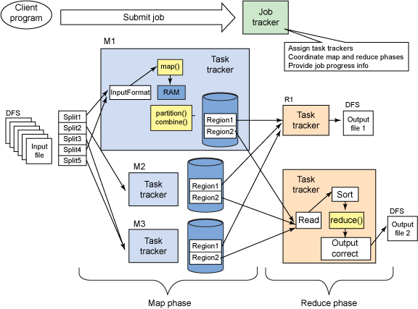
Hadoop mapreduce Architecture

Slide 10

Hdfs Architecture…

Slide 11
Description:
The resource manager works together with node manager and application manager.
Node manager will take the instructions from the resource manager and will manage resource available on a single node. Application masters are responsible for negotiating resources with resource manager and for working with node manager to start the containers.
The Node Manager (NM) is also YARN’s prenode agent, and takes care of the individual compute nodes in Hadoop cluster. The continuous features interaction such as air temperature, humidity would provide very valuable and efficient for most of the organization to work under any climatic condition.

Slide 12
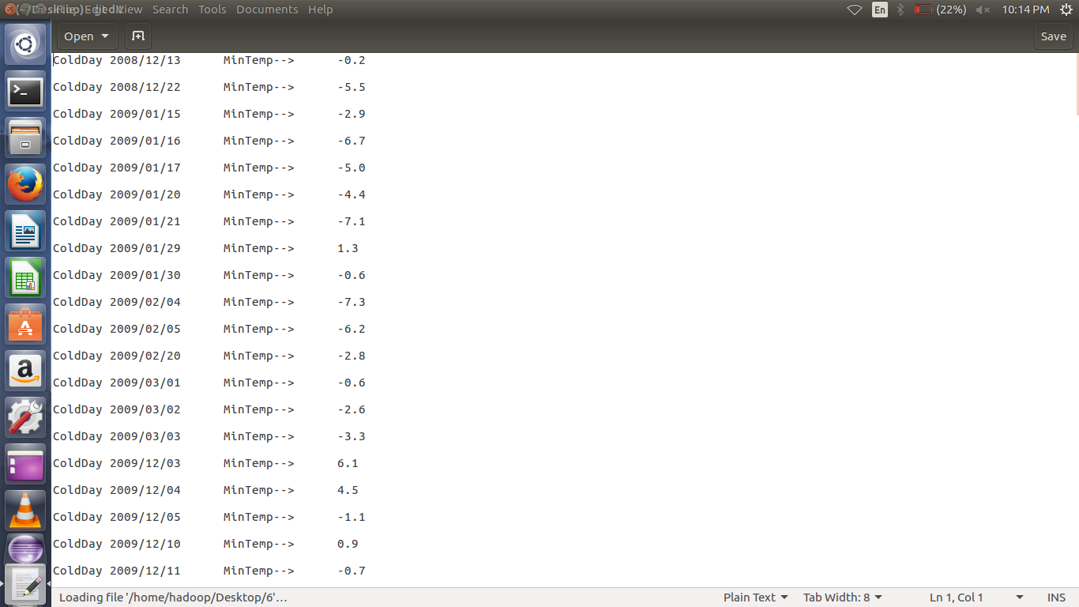
Weather dataset example 1.cold day

Slide 13
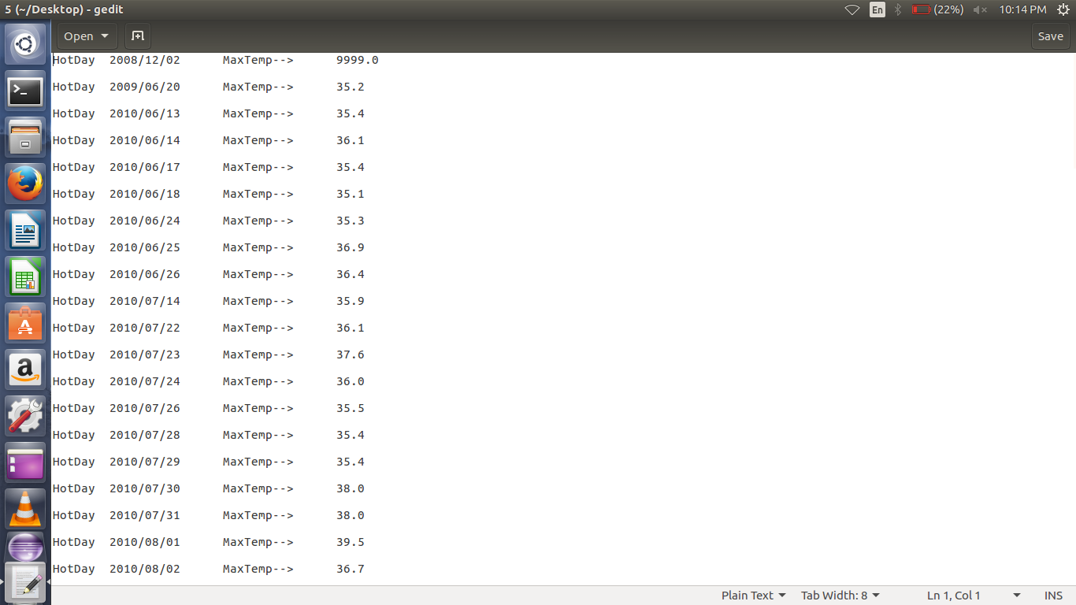
Weather dataset example 1.hot day

Slide 14
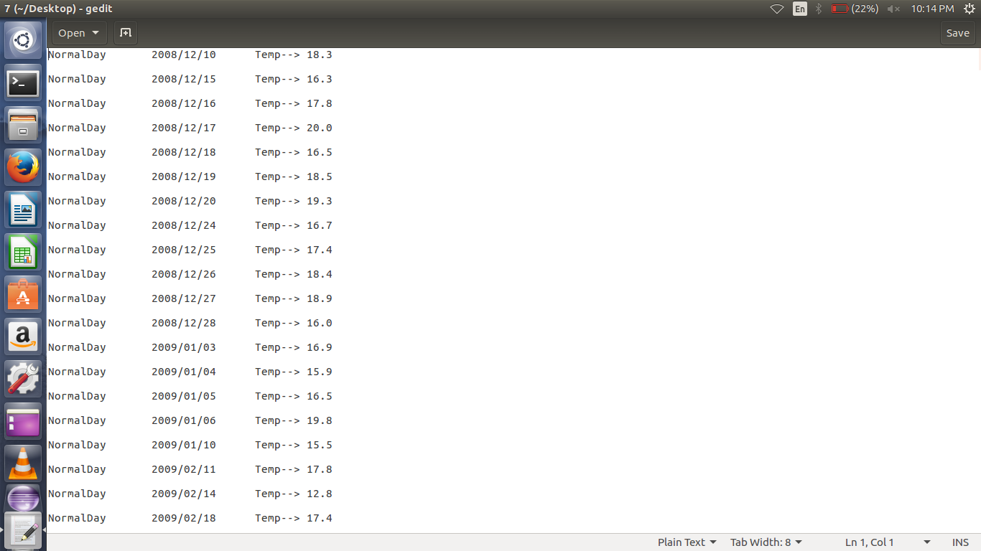
Weather dataset example 1.normal day

Slide 15
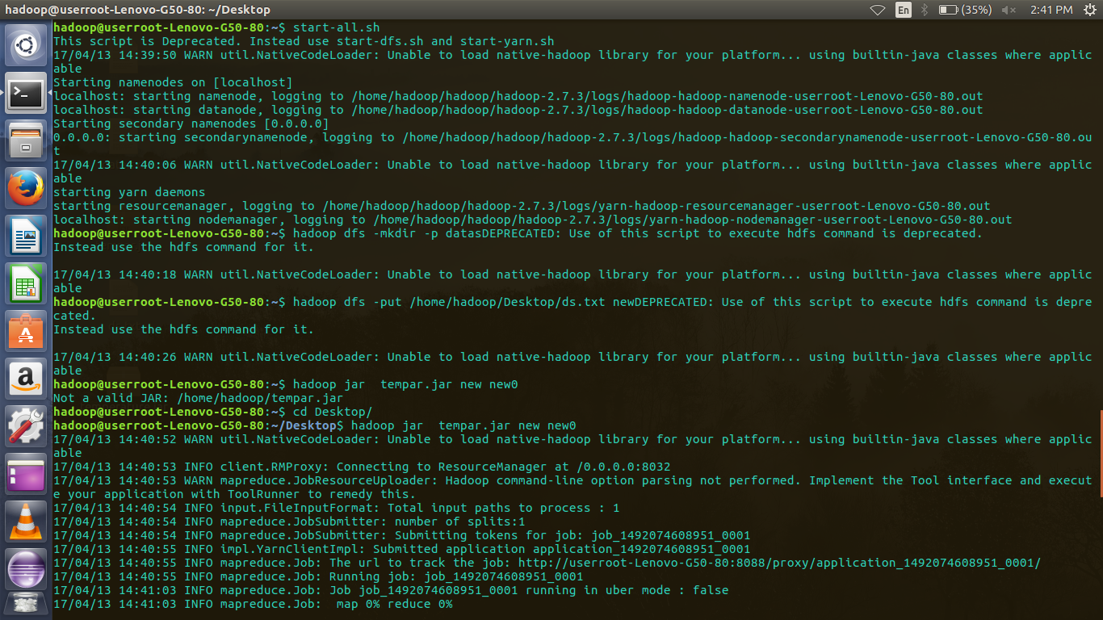
Screen Shot: 1

Slide 16
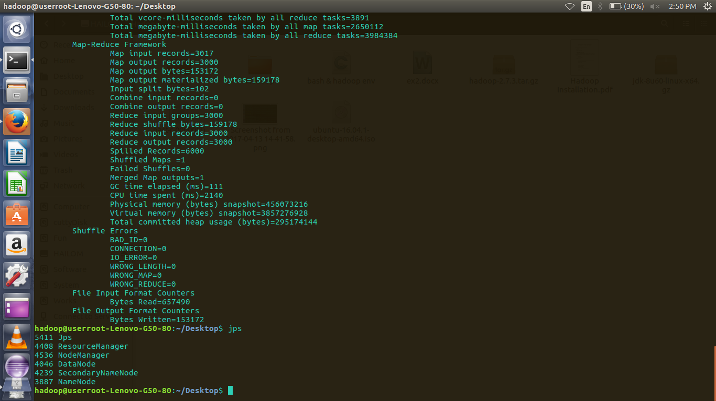
Screen Shot :2

Slide 17
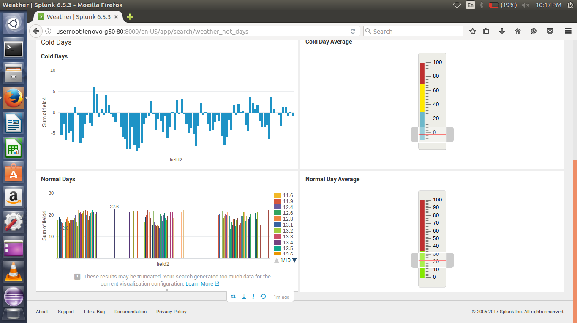
Screen Shot :3 Sample Dataset under Visualization

Slide 18
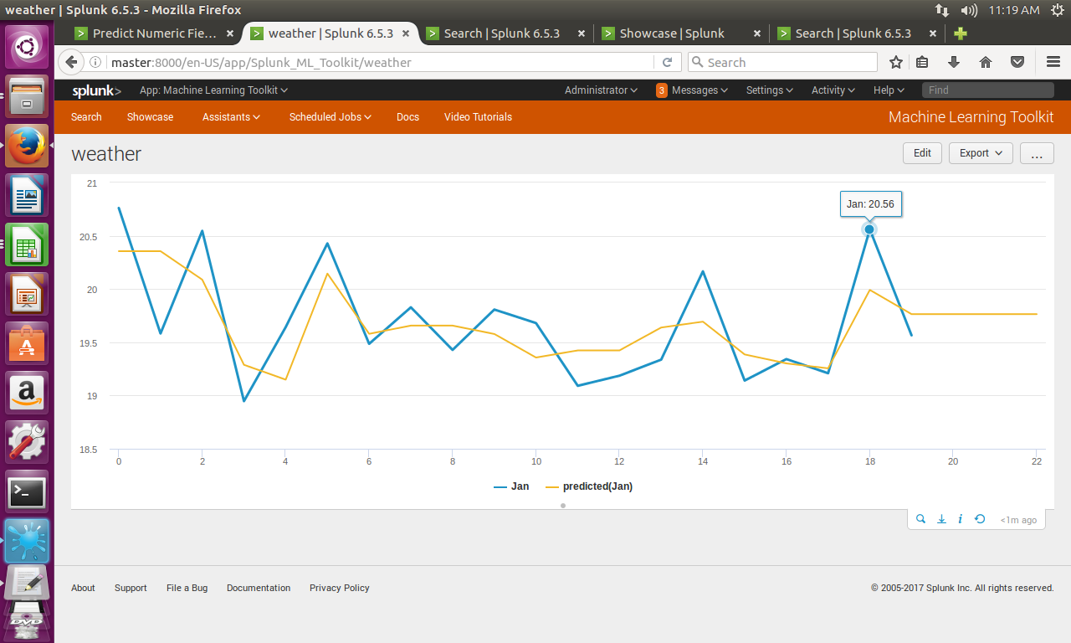
Screen Shot :3 Prediction -Yearwise temperature

Slide 19
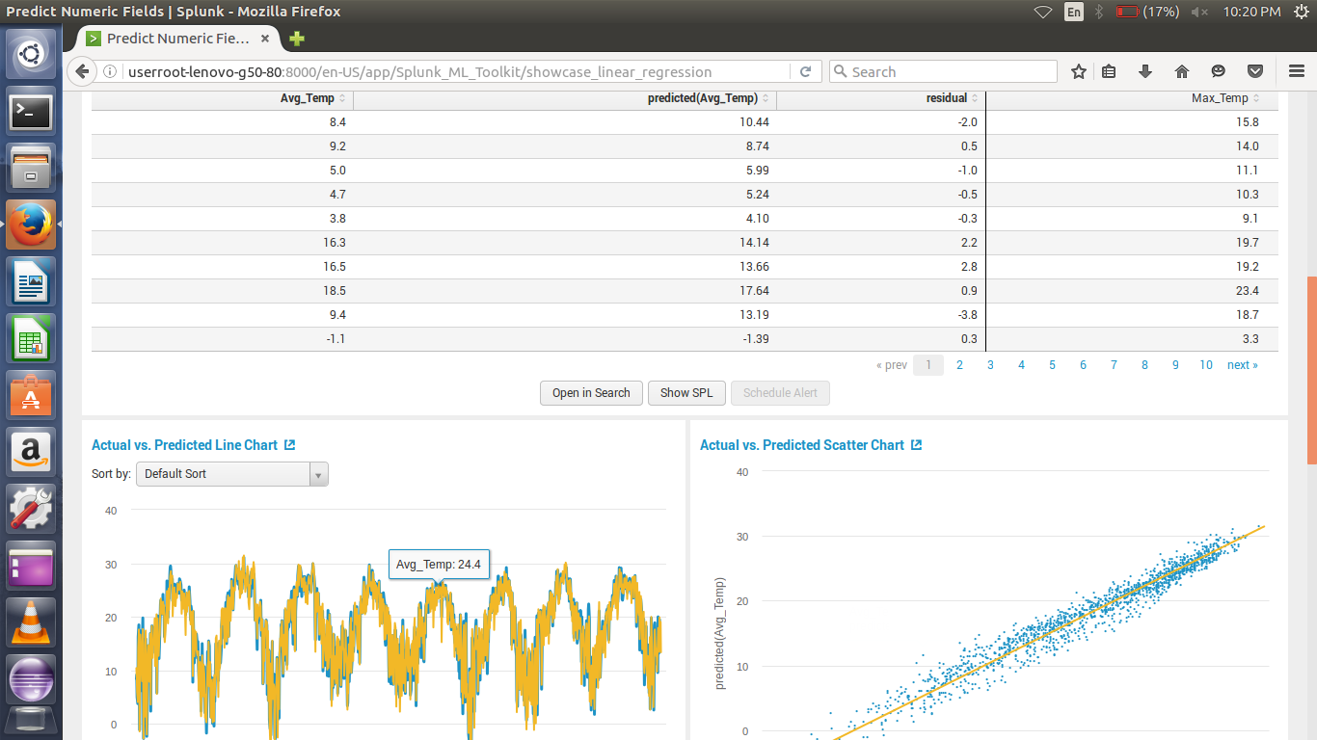
Screen Shot :3 Sample Dataset prediction under Visualization

Slide 20


